Slide 1
Computer ARCHITECTURE (CA)
Course Instructor
Hira beenish
Department of Computer Science

Slide 2
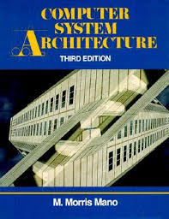
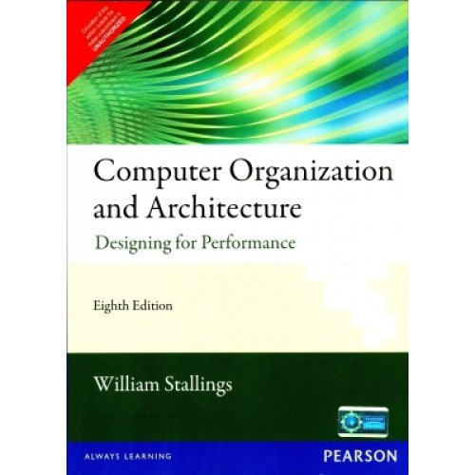
Recommended Books
Computer Systems Architecture, 3rd Edition
By M.Morris Mano; Prentice Hall International
Computer Organization and Architecture Designing For Performance By William Stallings

Slide 3
Chapters Included
1. Digital logic circuits
2. Digital components
3. Data Representation
4. Basic Computer Organization & Design →→Mid Term
5. Central processing unit
6.Pilpeline & vector processing
7. I/O & O/P organization
8 Memory Management
9. Multiprocessors

Slide 4
Chapter#6 Central processing unit

Slide 5
Contents
Introduction
General Register Organization
Stack Organization
Reverse polish notation
Instruction Formats
Addressing modes
Reduced Instruction Set Computer (RISC)
Complex Instruction Set Computer (CISC)

Slide 6
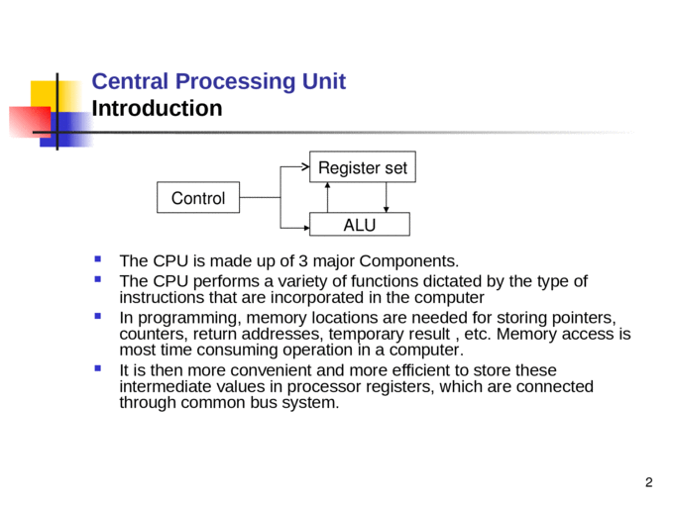

Slide 7
MAJOR COMPONENTS OF CPU
Storage components:
Registers
Flip-flops
Execution (processing) components:
Arithmetic logic unit (ALU):
Arithmetic calculations, logical computations
Transfer components:
Bus
Control components:
Control unit

Slide 8
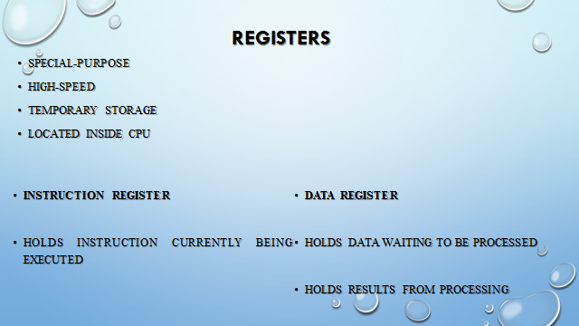

Slide 9
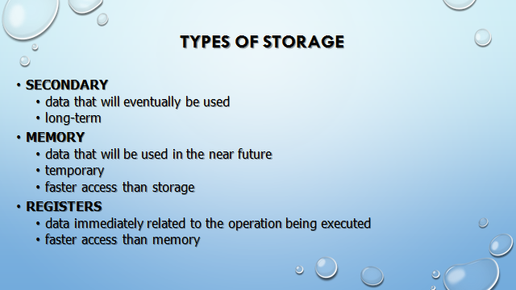

Slide 10
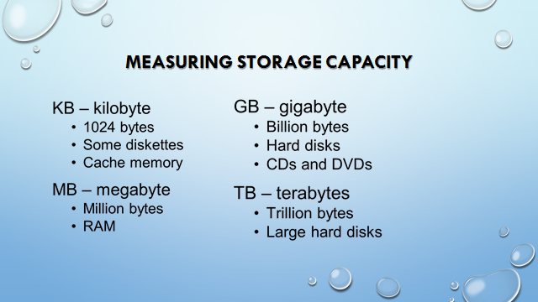

Slide 11
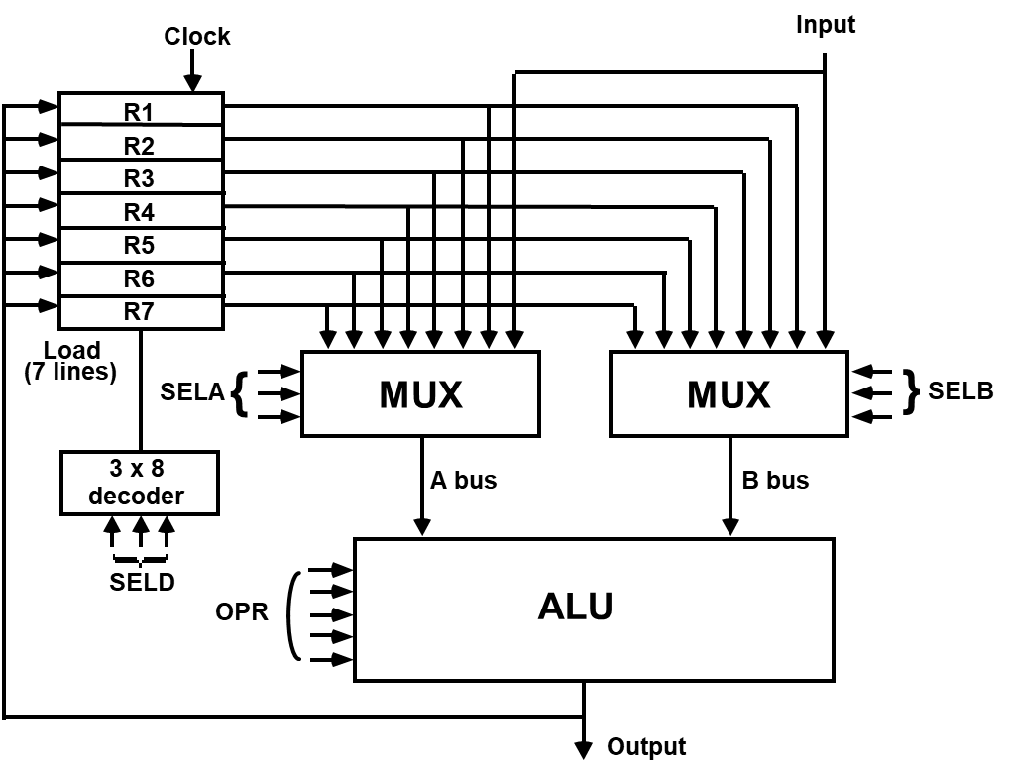
GENERAL REGISTER ORGANIZATION
External Input

Slide 12
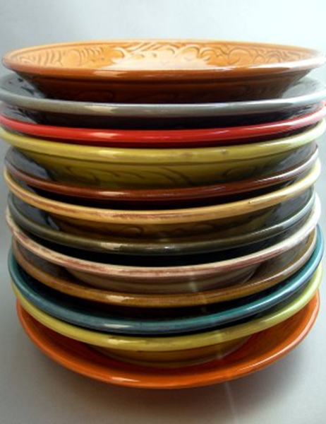
Stack or LIFO(Last-In, First-Out)

Slide 13
Stack or LIFO(Last-In, First-Out)
A stack is a specialized buffer which stores data from the top down.
Stack is a storage device that stores information in such a manner that the item stored last is the first item retrieved.
Stack pointer
The register that holds the address for the stack is called Stack pointer
stack pointer is a small register that stores the address of the last program request in a stack.
Two Operations of a stack : Insertion and Deletion of Items
PUSH : Push-Down = Insertion
POP : Pop-Up = Deletion

Slide 14
MEMORY STACK ORGANIZATION
A portion of memory is used as a stack with a processor register as a stack pointer
- PUSH: SP ← SP +1
M[SP] ← DR
- POP: DR ← M[SP]
SP ← SP -1
most computers do not provide hardware to check
stack overflow (full stack) or underflow(empty stack)
: Increment SP
: Write to the stack
: Check if stack is full
: Mark not empty

Slide 15
REGISTER STACK ORGANIZATION
very useful feature for loops control
Also efficient for arithmetic expression evaluation
Storage which can be accessed in LIFO
Pointer: SP
Only push and pop operations are applicable

Slide 16
REVERSE POLISH NOTATION
A stack organization is very effective for evaluating arithmetic expressions
The common mathematical method of writing arithmetic expressions impose difficulties when evaluated by a computer
Common arithmetic expressions are written in infix notation, with each operator written between the operands.
A + B Infix notation
+ A B Prefix or Polish notation
A B + Postfix or reverse Polish notation

Slide 17
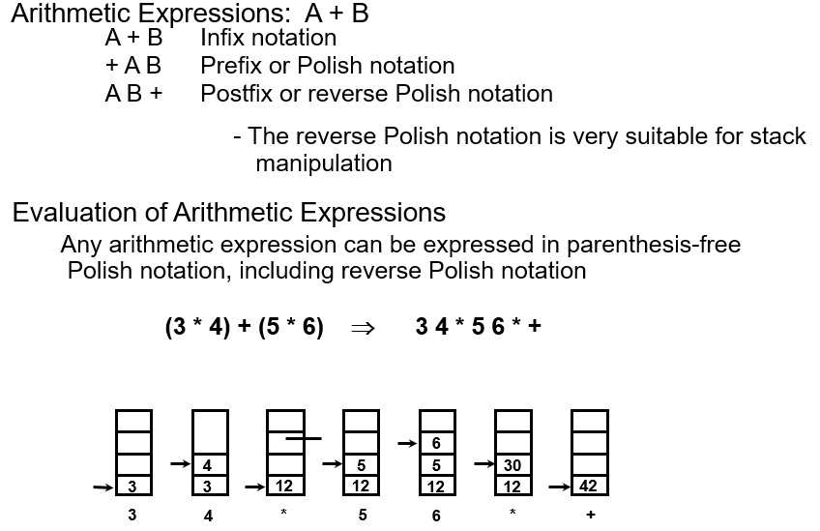
REVERSE POLISH NOTATION

Slide 18
REVERSE POLISH NOTATION
consider the infix expressions as
‘the postfix forms are:
( 5 + 6) * 9 +10
will be
5 6 + 9 * 10 +
In case of not using the parenthesis in the infix form, you have to see the precedence rule before evaluating the expression. in the above example, if we want to add first then we have to use the parenthesis. in the postfix form, we do not need to use parenthesis. the position of operators and operands in the expression makes it clear in which order we have to do the multiplication and addition.

Slide 19

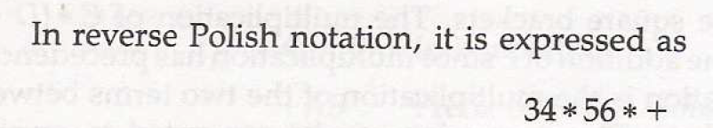
REVERSE POLISH NOTATION
the following numerical example clarify this procedure.
consider this expression

Slide 20
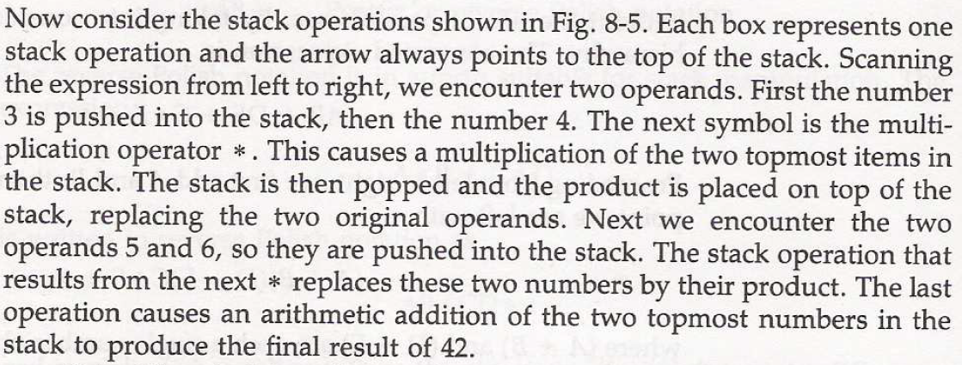
Stack operation

Slide 21

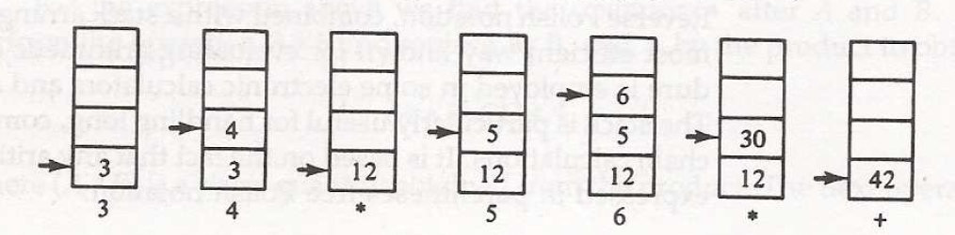

Slide 22
PROCESSOR ORGANIZATION
in general, most processors are organized in one of 3 ways
Single register (Accumulator) organization
basic computer is a good example
accumulator is the only general purpose register
General register organization
used by most modern computer processors
any of the registers can be used as the source or destination for computer operations
Stack organization
all operations are done using the hardware stack
for example, an or instruction will pop the two top elements from the stack, do a logical or on them, and push the result on the stack

Slide 23
Complex instruction set computer
CISC

Slide 24
What is CISC….?
A complex instruction set computer (CISC, pronounced like "sisk") is a microprocessor instruction set architecture (ISA) in which each instruction can execute several low-level operations, such as a load from memory, an arithmetic operation, and a memory store, all in a single INSTRUCTION.

Slide 25
Main Idea of CISC
The philosophy behind it is, that hardware is always faster than software, therefore one should make a powerful instruction set, which provides programmers with assembly instructions to do a lot with short programs.
So the primary goal of the CISC is to complete a task in few lines of assembly instruction as possible

Slide 26
Characteristics of a CISC design
Register to register, register to memory, and memory to register commands.
Uses Multiple addressing modes .
Variable length instructions where the length often varies according to the addressing mode
Instructions which require multiple clock cycles to execute.

Slide 27
Characteristics of a CISC design
High Performance General Purpose Instructions
Characteristics of CISC:
A large number of instructions (from 100-250 usually)
Some instructions that performs a certain tasks are not used frequently.
Many addressing modes are used (5 to 20)
Variable length instruction format.
Instructions that manipulate operands in memory.

Slide 28
RISC: REDUCED INSTRUCTION SET COMPUTERS
One instruction per cycle
Register to register operations
Few, simple addressing modes
Few, simple instruction formats
Fixed instruction format
More compile time/effort

Slide 29
CISC | RISC
Primary goal is to complete a task in as few lines of assembly as possible Emphasis on hardware complex instructions Memory-to-memory: "LOAD" and "STORE" incorporated in instructions Difficult to apply pipelining. Small code sizes, high cycles per second | Primary goal is to speedup individual instruction Emphasis on software reduced instruction only Register to register: "LOAD" and "STORE" are independent instructions Easy to apply pipelining. Low cycles per second, large code sizes

Slide 30
Thank you

